Slide 1
Vrinda Store Annual Sales Report 2022
By Fahila K P

Slide 2
What we need to analyse?
Month with highest sales and orders
Purchases by different gender
Different order statuses in 2022
Top 10 states contributing to sales
Relationship between age, gender and sales
Channel contributing to maximum sales
Highest selling category

Slide 3
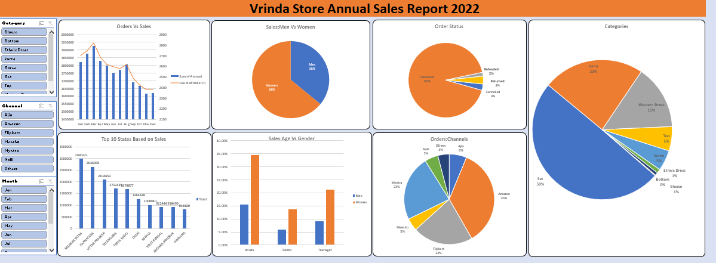
Dashboard

Slide 4
Sample Insights
The month march have highest sales and orders
Women are more likely to buy compared to men
92% of orders are delivered in 2022
Maharastra,Karnataka,uttarpradesh are the top 3 states contributing to sales
Women in adults age groups contributing more to sales
Amazon,Myntra,flipkart are the channels contributing to maximum sales
Set is the highest selling category

Slide 5
Conclusion
Vrinda store can improve their sales by targeting women customers in adult age group residing in Maharastra,Karnataka,Uttarpradesh through the channels Amazon,Mynta and Flipkart.

